Slide 1



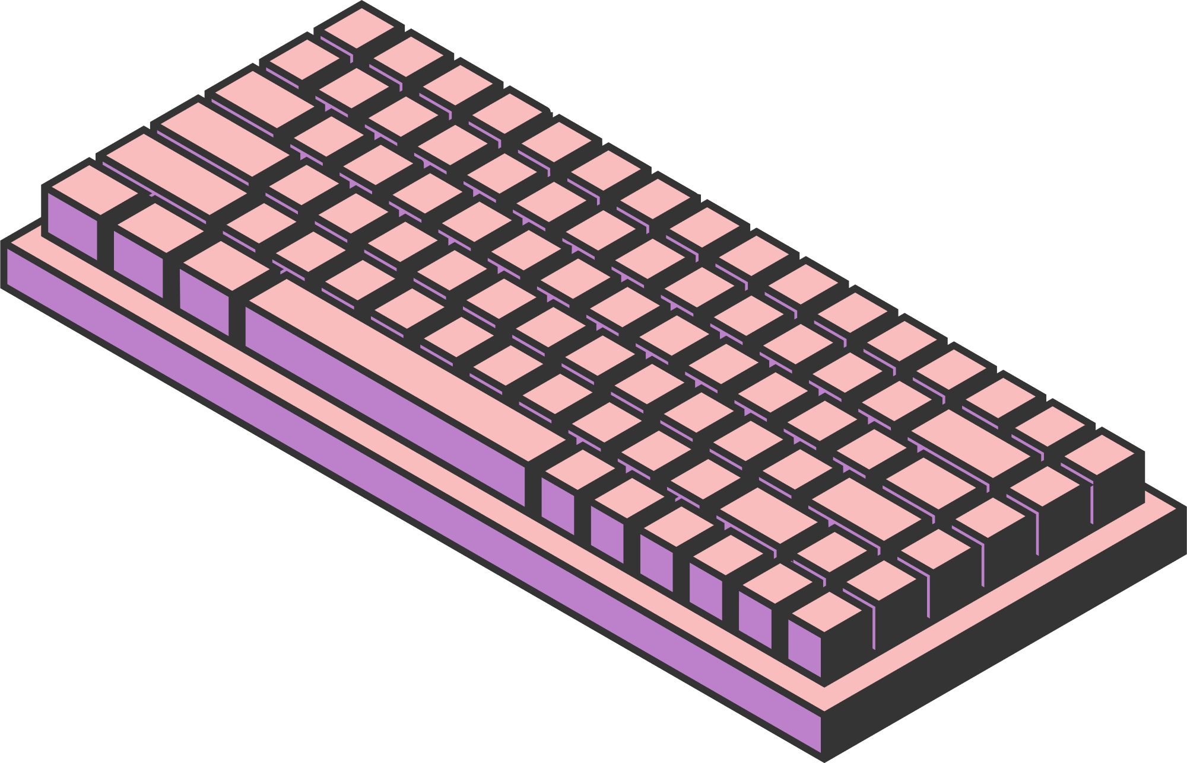

COLLEGE MANAGEMENT SYSTEM
HOME
SERVICE
ABOUT US
CONTACT US
DBMS
COURSE – DBMS [CSL 301]
GUIDED BY - DR. SHISHUPAL
BY:
PRATEEK VASHISHTH [BT22CSE224]
KAMAL CHANDRA [BT22CSE223]
HARSH AGARWAL [BT22CSE228]
AMRUTHA KUMAR K [BT22CSE213]
Page 01

Slide 2


INTRODUCTION
HOME
SERVICE
ABOUT US
CONTACT US
Objective:
Develop an College management system to manage college operations.
Key Features:
Role-based login for Students, Faculty, and Admin.
Centralized management of courses, fees, notices, and resources.
DBMS
Page 02

Slide 3



SYSTEM ARCHITECTURE & TECHNOLOGIES
HOME
SERVICE
ABOUT US
CONTACT US
COMPONENTS
Frontend: Flutter
Backend: Node.js
Database: MySQL
Structure:
Modular architecture with role-based access for Students, Faculty, and Admin.
Page 03

Slide 4
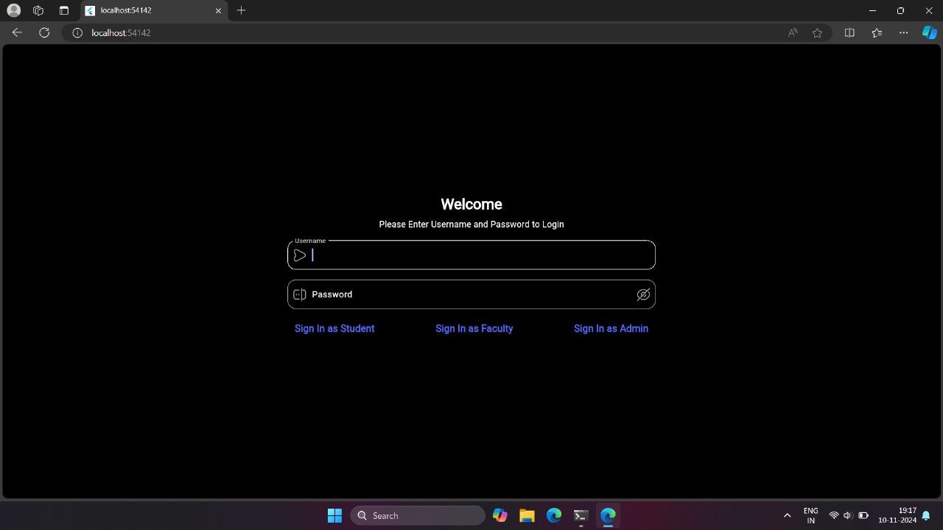
LOGIN & USER ROLES
HOME
SERVICE
ABOUT US
CONTACT US
Login Screen:
Welcome page with login options for Students, Faculty, and Admin.
Tailored access based on user roles, directing each user to their specific panel upon login.
Page 04

Slide 5
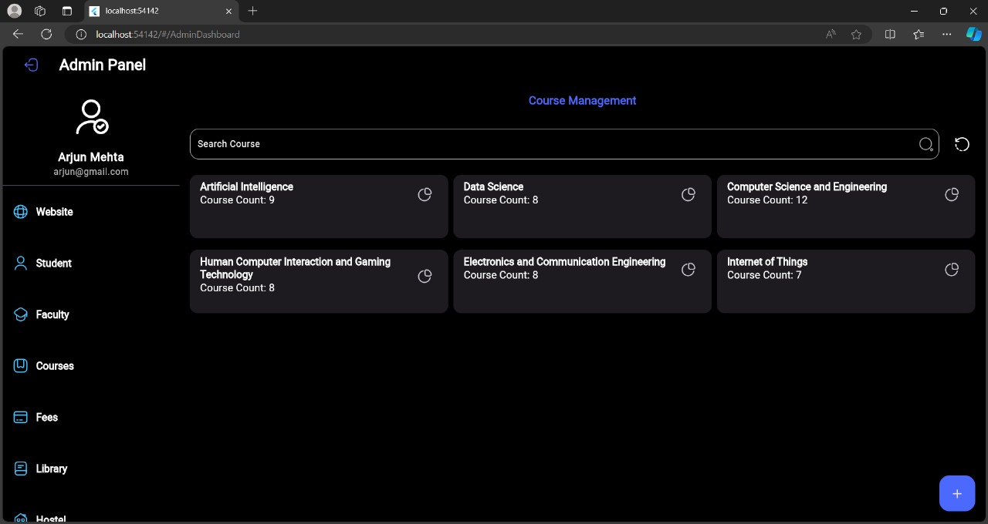
ADMIN PANEL
HOME
SERVICE
ABOUT US
CONTACT US
Overview:
Admin dashboard with options for managing notices, courses, and student data.
Key Features:
Notices for events, fee deadlines, and exams.
Sections to manage Website, Student, Faculty, Courses, Fees, Library, Placement, Alumni and Hostel.
Page 05

Slide 6
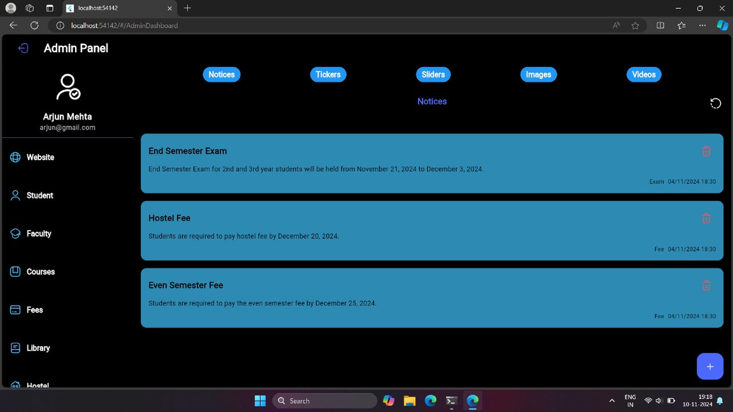
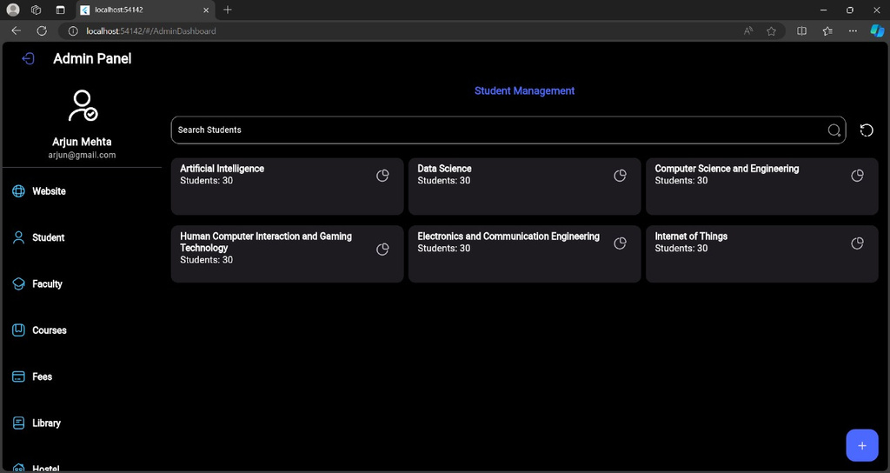

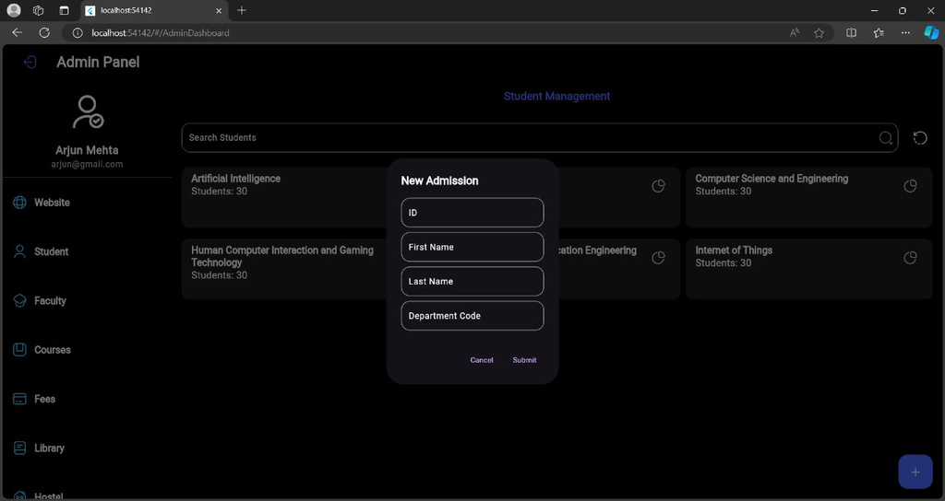
HOME
SERVICE
ABOUT US
CONTACT US
Page 10

Slide 7
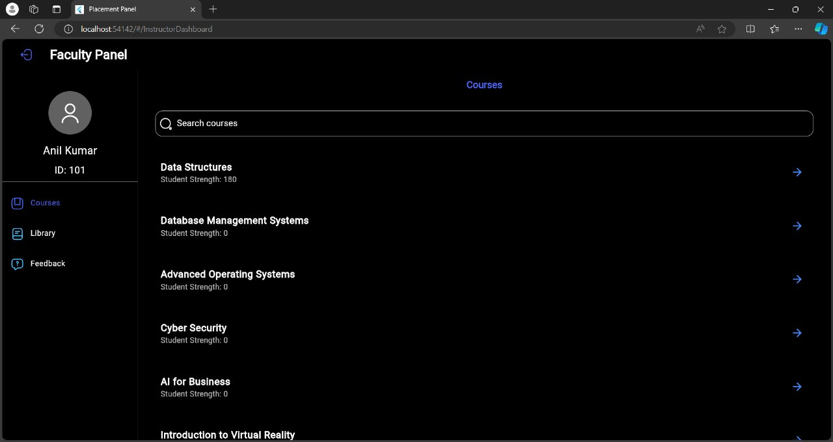
FACULTY PANEL
HOME
SERVICE
ABOUT US
CONTACT US
Overview:
Customized dashboard for Faculty.
Key Features:
Faculty name and ID displayed.
Search functionality for courses.
Lists all courses taught, with student strength for each course.
has Courses, Library and feedback management options
Page 07

Slide 8
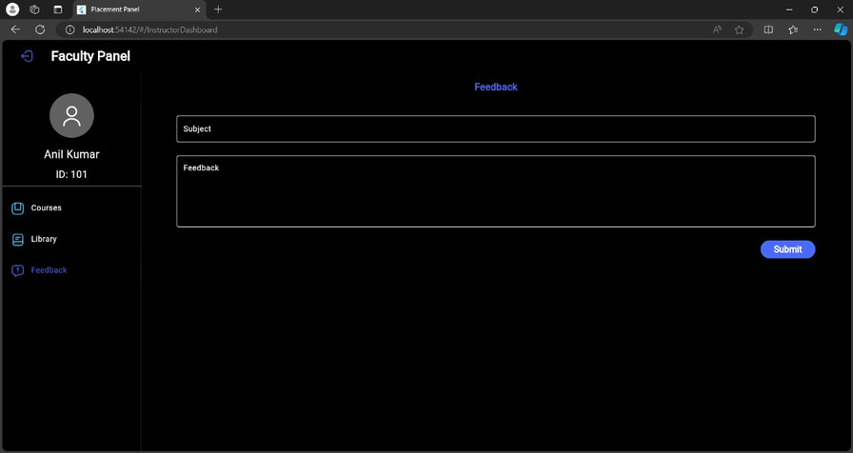
HOME
SERVICE
ABOUT US
CONTACT US
Page 10

Slide 9
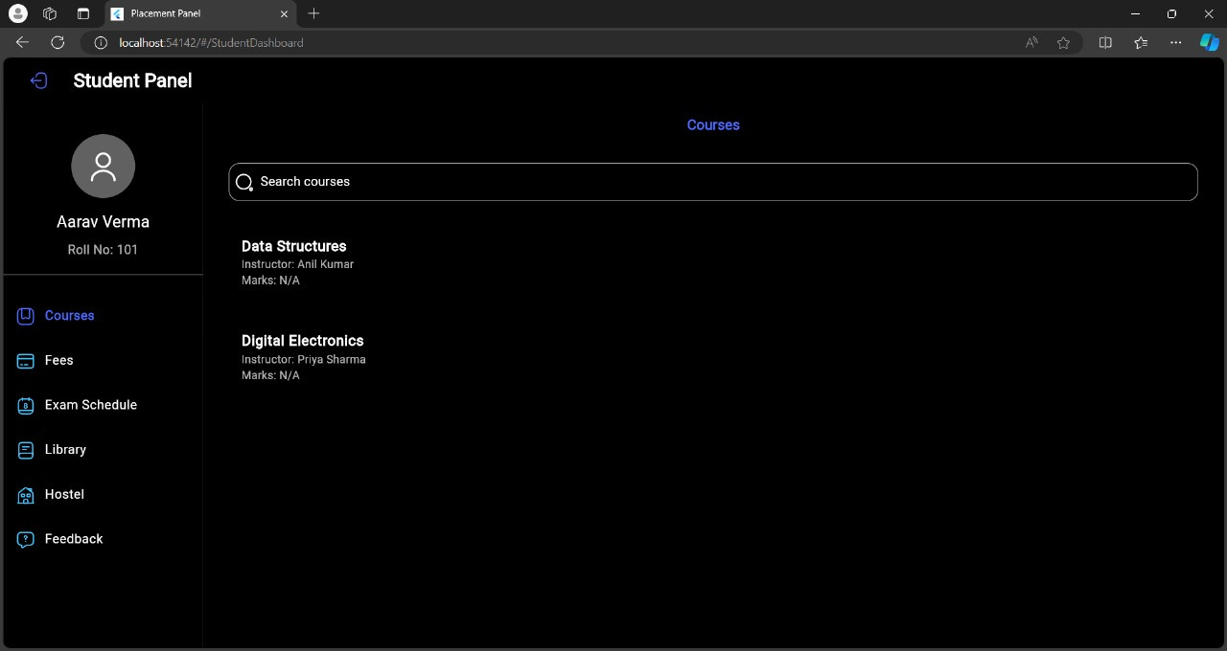
STUDENT PANEL
HOME
SERVICE
ABOUT US
CONTACT US
Overview:
Student dashboard displaying relevant information.
Key Features:
Student's name and roll number.
Has options like viewing of Courses, Fees, Exam Schedule, Library, Hostel, and feedback forms
Page 09

Slide 10
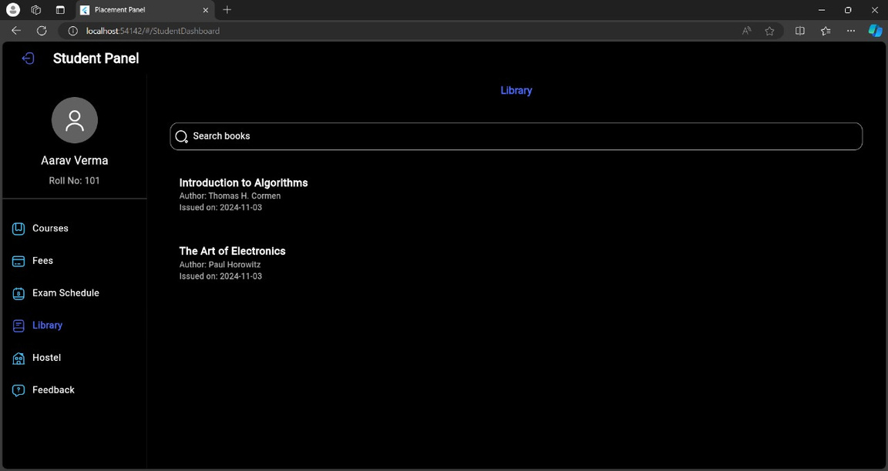
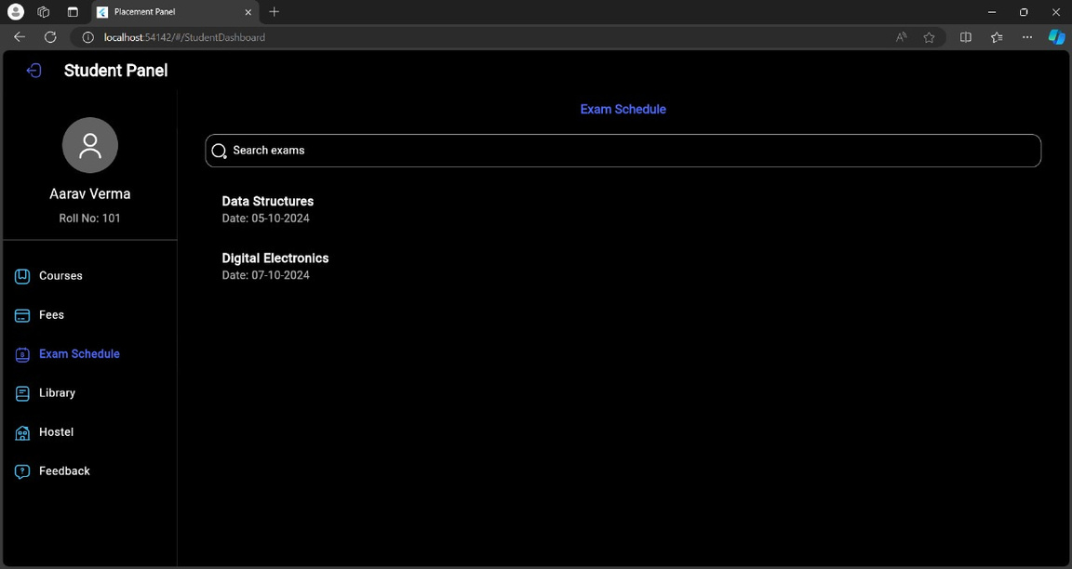
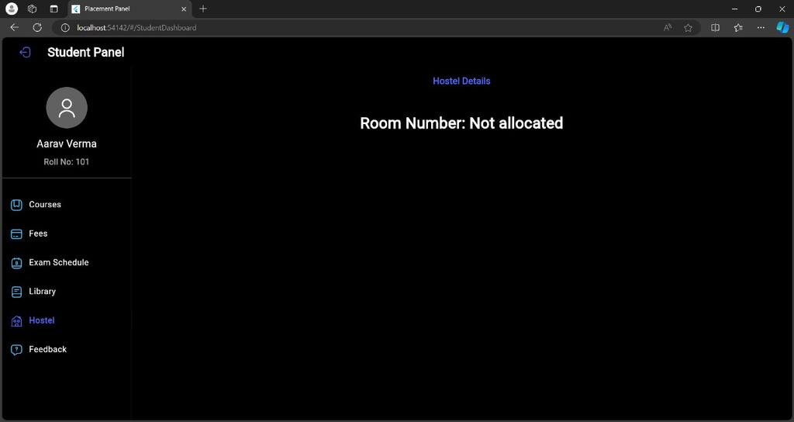
HOME
SERVICE
ABOUT US
CONTACT US
Page 10

Slide 11


HOME
SERVICE
ABOUT US
CONTACT US
THANK YOU
Page 11

